Slide 1
HyperText Markup Language (HTML)

Slide 2
HTML (Hypertext Markup Language) is a markup language that allows users to create static web pages.
An HTML file contains markup tags (elements). A tag is a text instruction that tells the web browser how to display the contents between the tags.

Slide 3
An HTML file must have a .htm or .html file extension.
The file can be created using a text editor.

Slide 4
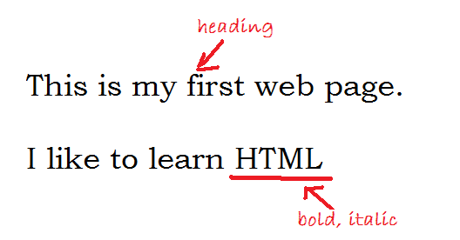

Slide 5
HTML Tags
HTML tags are keywords surrounded by angle brackets like <html>
HTML tags normally come in pairs.
The first tag in a pair is the start tag, the second tag is the end tag.

Slide 6
The general format of an HTML tag:
<tagname attribute = “value”>……</tagname>
tag content
Start tag
End tag

Slide 7
The start tag indicates the beginning of a command and the end tag, with a forward slash ( / ) inside it, indicates where that command should end.
HTML tags are not case sensitive.
HTML tags can have attributes.

Slide 8
Attributes provide additional information about the tag to the browser.
Attributes are always specified in the start tag.

Slide 9
Example:
Tag contents
End tag
Start tag
<H1 align = “center”>Hello World</H1>
Attribute value
Attribute

Slide 10
Elements (tag) with no tag content are called empty tags.
An empty tag takes the following format:
<tagname attribute = “value” />

Slide 11
Basic Structure of an HTML Document
<html>
<head>
<title> My First HTML Documents </title>
</head>
<body>
<h1>Hello World</h1>
</body>
</html>
Head
Section
Body Section
HTML
tags

Slide 12
HTML documents start with the <HTML> tag and ends with </HTML>.
HTML documents are divided into two sections: the head and the body.
The head section contains information about the document such as the title of the web page, information about the web page required for search engines, style sheets etc.

Slide 13
The head section starts with the <HEAD> tag and ends with </HEAD>.
Information contained in the head section is not displayed within the browser.

Slide 14
The body section contains the contents of the web page.
The body section starts with the <BODY> tag and ends with </BODY>.

Slide 15
HTML Tags

Slide 16
Tags used in the Head Section
<title> - Defines the document title.
<meta>
Provides meta-information about the web page, such as descriptions and keywords for search engines, refresh rates etc.
It has no end tag.

Slide 17
Attributes:
Attribute | Values
http-equiv | refresh | For creating automatic jumps to other pages, setting refresh rates etc.
name | description keywords | For identifying extra information on the web page.
content | Some text | Adds extra information about the web page. It is associated with http-equiv or name attributes.

Slide 18
Examples:
Define keywords for search engines
Define a set of key words to describe a web page
created to give information about the Internet
Technology module.
<meta name="keywords" content="HTML, CSS,
JavaScript” />

Slide 19
Define a description of web page for search engines
Give a description about a web page created
to give information about the Internet
Technology module.
<meta name="description"
content=“Internet technology module will teach you
HTML, CSS, PHP and JavaScript" />

Slide 20
Refreshing a web page
Refresh the web page every 5 seconds
<meta http-equiv=“refresh” content=“5” />

Slide 21
Redirecting a user to another web page
Redirect the web page to www.nsbm.lk after
2 seconds.
<meta http-equiv="refresh" content="2; url=http://www.nsbm.lk"/>

Slide 22
Tags used in the Body Section

Slide 23
Attributes of the <body> tag:
Attribute
background | Specifies a background image
bgcolor | Specifies a background color
text | Specifies the color of the text

Slide 24
Example:
<body bgcolor=“black” text=“white”>
……
</body>
<body background=“picture1.jpg” >
……
</body>

Slide 25
Example 1:
Create an HTML document with the following effects:
Set the page title to “Welcome to My First Web Page”
Set the background color to “black”.
Set the text color to “yellow”
Include the text “I like to learn HTML”

Slide 26
<html>
<head>
<title> Welcome to My First Web Page</title>
</head>
<body bgcolor=“black” text=“yellow”>
I like to learn HTML
</body>
</html>

Slide 27
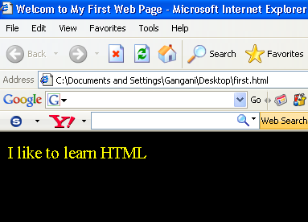

Slide 28
Example 2:
Create a web page to include the following:
Page title – ABC Bookworld Ltd.
Page background - #F8F400
Text color - #3D001C
Set of suitable keywords for search engines.

Slide 29
Redirect the page to http://www.abcbookmain.com after 10 seconds.
Page contents : a message indicating that the user will be redirected to the bookshop main page.

Slide 30
<html>
<head>
<meta name=“keywords” content=“books, CDs, Magazines” >
<meta http-equiv=“refresh” content=“10; url=http://www.abcbookmain.com” >
<title> ABC Bookworld Ltd</title>
</head>
<body bgcolor=“#F8F400” text=“#3D001C”>
You will be redirected to our main page in 10 seconds </body>
</html>

Slide 31
Basic Paragraph Text Tags

Slide 32
Paragraphs
The <p> tag marks the beginning of a paragraph.
</p> tag is optional.
HTML automatically leaves an extra blank line before and after a paragraph.

Slide 33
Attributes:
Align (values: Center, left, right and justify).
Example:
<p align = “center”>
This paragraph is center aligned
</p>

Slide 34
Line Breaks
The <br> tag is used to end a line without starting a new paragraph. The tag forces a line break wherever it is placed.
The <br> tag has no end tag.

Slide 35
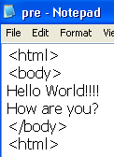
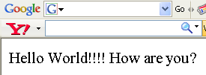

Slide 36
Preformatted Text
The <pre> tag defines preformatted text. The text enclosed in the pre element usually preserves spaces and line breaks.

Slide 37
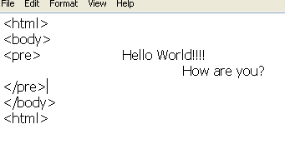
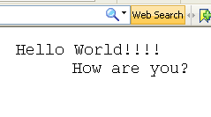

Slide 38
Horizontal Rule
The <hr> tag inserts a horizontal rule.
The tag has no end tag.
Center
The <center> tag centers its enclosed text horizontally.

Slide 39
Example 2:
Create the following web page using HTML:
Sun Ray Holiday Resorts
Sun Ray is a beach hotel where you can have the best holiday ever.
For more information please contact:
Bookings Manager
Tel: 234-5677 or 234-5688

Slide 40
<html>
<body>
<center> Sun Ray Holiday Resorts</center>
<hr>
<p>Sun Ray is a beach hotel where you can <br> have the best holiday ever. </p>
<hr>
For more information please contact:
<pre> Bookings Manager
Tel: 234-5677 or 234-5688
</pre>
</body>
</html>

Slide 41
Comments
Comments are ignored by the browser.
A comment is written between the <! - - and - - > symbols.
Example:
<! - - This is a comment - - >

Slide 42
Lists
Two types of lists are supported in HTML: definition (glossary) lists and regular lists.
Definition Lists
Contains a term followed by a definition.

Slide 43
A definition list starts with the <dl> tag. Each definition-list term starts with the <dt> tag and each definition of a term starts with the <dd> tag.

Slide 44
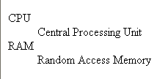
Example:
Create the following definition list:

Slide 45
Example:
<dl>
<dt> CPU </dt>
<dd> Central Processing Unit </dd>
<dt> RAM </dt>
<dd> Random Access Memory </dd>
</dl>

Slide 46
Example 2:
Create a web page using HTML to display the
following definition list:
Mount Everest
Tallest Mountain in the world
Nile
Longest river in the world
Angel Falls
Highest waterfall in the world

Slide 47
<dl>
<dt> Mount Everest </dt>
<dd> Tallest Mountain in the world </dd>
<dt> Nile </dt>
<dd> Longest river in the world </dd>
<dt> Angel Falls </dt>
<dd> Highest waterfall in the world </dd>
</dl>

Slide 48
Regular Lists
Regular lists can be categorized as ordered lists and unordered lists.
Ordered Lists
It is a list of items with the list items marked with numbers.

Slide 49

An ordered list starts with the <ol> tag. Each list item starts with the <li> tag.
Example 1:
Create the following ordered list:

Slide 50
<ol>
<li> Apples </li>
<li> Oranges </li>
<li> Grapes </li>
</ol>

Slide 51
Unordered Lists
It is a list of items with the list items marked with bullets.
An unordered list starts with the <ul> tag. Each list item starts with the <li> tag.

Slide 52

Example:
Create the following unordered list:

Slide 53
<ul>
<li> Cricket </li>
<li> Football </li>
<li> Chess </li>
</ul>

Slide 54
Example 2:
Create a web page using HTML to display the
following ordered list:
Item list:
Books
CDs
Stationary
Toys

Slide 55
Text Styles

Slide 56
Headings
Headings are defined with <h1> to <h6> tags. <h1> defines the largest heading. <h6> defines the smallest heading.
HTML automatically adds an extra blank line before and after a heading.

Slide 57
Attributes:
Align (values: Center, left and right).
Example:
<h1 align = “center”> This is a heading </h1>

Slide 58
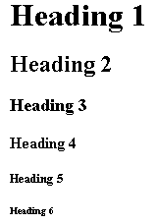
H1
H2
H3
H4
H5
H6

Slide 59
Bold Text
The <b> tag displays text in boldface.
Italic Text
The <i> tag displays text in italics.

Slide 60
Underlined Text
The <u> tag displays text that is underlined

Slide 61
Fonts
The <font> tag specifies the font face, font size, and font color of text.
Example:
<font face="Arial" color="red” size="1" > Hello World
</font>

Slide 62
Note:
A value of 3 for the size attribute represents the browser’s default size for text (usually 16 pixels).

Slide 63
Example:
Create the following web page using HTML:
H1 heading
Font face: Arial
Color: red
Book Sale !!!!
Over 40% discount on all Computer Science textbooks….
Hurry come and visit our bookshop.
Font face: Tahoma
Size: 4
Font face: Garamond
Size: 6

Slide 64
<html>
<body>
<h1 align=“center”><font face="Arial" Color="red">Book Sale!!!</font></h1>
<p><font face="Tahoma" size="4">Over <u>40%</u> discount on all<br>
<b>Computer Science</b> textbooks....</font></p>
<p>
<i><font face="Garamond" size=“6">Hurry come and visit our bookshop.</font></i></p>
</body>
</html>

Slide 65
Hyperlinks
The <a> tag (anchor tag) is used to create links.
Creating links to other web pages:
Syntax:
<a href = “URL”> …….</a>
Example:
<a href =“hello.html”> Click Here </a>

Slide 66
Example:
Create the following web page using HTML:
Sorry We have moved!!
You will be automatically redirected to our new site in 10 seconds or click the link given below:
Visit New site
Hyperlink to:
http://www.bookshop.com

Slide 67
<html>
<head>
<meta http-equiv=“refresh” content=“10; url=http://www.bookshop.com”></head>
<body>
<h1 align=“center”>Sorry we have moved</h1>
<p> You will be automatically redirected to <br>our new site in 10 seconds or click the link <br>given below:</p>
<center>< a href=“http://www.bookshop.com”> Visit new site</a> </center>
</body></html>

Slide 68
Images
The <img> tag places an image in an HTML document. It has no end tag.
Syntax:
<img src = “URL”> where src = “URL” specifies the location of the image on the server.
Attributes: align (values: left, right), width, height

Slide 69

Example 1:
Create the following web page using HTML. Use suitable formatting.
School.jpg
Hello World!!!!
This is my School.

Slide 70
<html>
<body>
<img src="school.jpg“/>
<h1 align="center"><font color="red">Hello World!!!</font></h1>
<h3 align=“center”><i>This is my school </i></h3>
</body>
</html>

Slide 71
Example 2:
Create the following web page using HTML. Add a suitable title, a background color, font types and font sizes to the document.

Slide 72
House.jpg
House for Rent
A two bedroom house for rent at:
120, Wijerama Lane,
Colombo.
Monthly rental :Rs 8,000

Slide 73
<html><head>
<title>House for Rent</title></head>
<body>
<img src=“house.jpg" align="left">
<h1 align="center"><font color="red"><u>House for rent</u></font></h1>
<p><font face="Garamond" size="4">A two bedroom house for rent at:<br>

Slide 74
120, Wijerama Lane,<br>
Colombo.<br></font>
<font face="Tahoma" size="5" color="blue"><u><i>Monthly rental : Rs 8,000 </i></u></font>
</p>
</body>
</html>

Slide 75
H1 heading, Center
Image:tree.gif
The Garden Shop
Every thing you need for your garden under one roof…..
H3 heading
Garden Tools
Fertilizers
Pots & plants etc
Background
Color:#7DC623
You can also get expert advice on gardening from our friendly staff. Call us to make an appointment. They will visit you.
Paragraph
Font color:green
Face:Arial
100, Colombo Road,
Kandy Tel: 234-56789
Preformatted
text
Hyperlink to:
www.gardenb.com
Visit our branches

Slide 76
<html><body bgcolor="#F8F400">
<img src="tree.jpg" align="left" width="50" height="75“/>
<h1><center><font color="green">The Garden Shop</font></center></h1>
<h3>Everything you need for your garden under one roof....</h3>
<hr>
<ul>
<li>Garden Tools</li>
<li>Fertilizers</li>
<li>Pots and Plants etc...</li>
</ul>
<hr>

Slide 77
<p><font face="Arial" color="green">You can also get <u> expert advice</u> on gardening from<br>
our friendly staff. Call us to make an appointment.<br>
They will visit you.
</p>
<br>
<pre><font face="Arial"> 100, Colombo Road,
Kandy. Tel:234-5678
</font>
</pre>
<br>
<a href="http://www.gardenb.com">Visit our Branches</a>
</body></html>

Slide 78
Tables
Tables are defined with the <table> tag.
A table is divided into rows with the <tr> tag, and each row is divided into data cells with the <td> tag.
Headings in a table are defined with the <th> tag.

Slide 79
Attributes:
Border | Adds a border to the table. A value 0 means no border as measured in pixels.
Align | Alignment of table or text within individual cells. (values : left, center, right).
Bgcolor | Background color of table or individual cells.

Slide 80
Width | Specifies the width of the table (in terms of pixels or as a percentage) or of individual cells.
Cellpadding | Setting of space (in pixels) between a cell’s content and its borders.
Cellspacing | Setting the amount of space (in pixels) between cells.

Slide 81
Example 1:
Write the HTML code to display the following table:
Student No | Name
ST100 | Nimal
ST200 | Mala

Slide 82

<html><body>
<table>
<tr><th> Student No. </th>
<th> Name </th></tr>
<tr><td>ST100</td>
<td>Nimal</td></tr>
<tr><td>ST200</td>
<td>Mala</td></tr>
</table>
</body></html>

Slide 83
Example 2:
Design an HTML document to display the following table:
Item | Price
Rice | 70
Sugar | 60
Dhal | 75
Flour | 40

Slide 84

<html><body>
<table border=“1”>
<tr><th>Item</th>
<th>Price</th></tr>
<tr><td>Rice</td>
<td align= “center”>70</td></tr>
<tr><td>Sugar</td>
<td align= “center”>60</td></tr>
…….
</table>
</body></html>

Slide 85
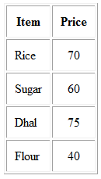
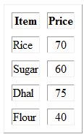
With cell padding
With cell spacing

Slide 86
Table Captions
The <caption> tag creates a table caption.
The tag should appear directly below the <table> tag, before the first <tr>.
Attributes:
Align ( values : top, bottom, left , right).

Slide 87
Example 2:
Create the following table:
Town | Province
Colombo | Western
Kandy | Central
Galle | Southern
Towns & Their Location

Slide 88
<html><body>
<table border=“1” align=“center” width=“50%”>
<caption align=“bottom”> Towns & Their Locations </caption>
<tr bgcolor=“green”>
<th> Town</th>
<th>Province</th></tr>
<tr bgcolor=“blue”><td>Colombo</td>
<td align=“center”>Western </td></tr>
<tr><td>Kandy</td>
<td align=“center”>Central</td></tr>

Slide 89
<tr bgcolor=“blue”>
<td>Galle</td>
<td align=“center”>Southern</td></tr>
</table>
</body>
</html>

Slide 91
Starting the web page:
<!DOCTYPE HTML PUBLIC “_//w3c/DTD HTML 4.0//EN”>
Declares the version of HTML the page is using

